Slide 1
Empowering Growth: Data-Driven Long-Term Deposit Strategies
Analysis and Recommendations
Mohammad Saleh

Slide 2

Business Case
Objective: To mitigate revenue decline by identifying existing customers with a higher likelihood of subscribing to long-term deposits, focusing marketing efforts to enhance capital accumulation for the Portuguese Bank amid economic challenges.
There has been a revenue decline in the Portuguese Bank and they would like to know what actions to take. After investigation, they found that the root cause was that their customers were not investing enough for long-term deposits. So the bank would like to identify existing customers with a higher chance to subscribe for a long-term deposit and focus marketing efforts on such customers.

Slide 3

Data Exploration
Data Source: Kaggle
https://handwiki.org/wiki/Finance:2010%E2%80%9314_Portuguese_financial_crisis
32950 rows
29238 have said no (88.73%)
3712 have said yes (11.27%)

Slide 4
Data Dictionary
Classification Labels
Customer Demographics
Age | age of a person
Job | type of job ('admin.','blue-collar','entrepreneur','housemaid','management','retired','self-employed','services','student','technician','unemployed','unknown')
Marital | marital status ('divorced','married','single','unknown'; note: 'divorced' means divorced or widowed)
 | Financial Indicators
Education | ('basic.4y','basic.6y','basic.9y','high.school','illiterate','professional.course','university.degree','unknown')
Default | has credit in default? ('no','yes','unknown')
Housing | has housing loan? ('no','yes','unknown')
Loan | has personal loan? ('no','yes','unknown')
 | Contact
pdays | number of days that passed by after the client was last contacted from a previous campaign (999 means client was not previously contacted)

Slide 5
Model Approaches
Model | F1 | Recall | Precision | Accuracy | ROC AUC
Logistic Regression | 0.29 | 0.18 | 0.63 | 0.89 | 0.74
KNN | 0.31 | 0.21 | 0.64 | 0.90 | 0.70
Random Forest | 0.30 | 0.19 | 0.65 | 0.90 | 0.74
Boosted Tree | 0.29 | 0.19 | 0.59 | 0.89 | 0.74
Xgboost | 0.33 | 0.23 | 0.56 | 0.89 | 0.72
ANN (MLP) | 0.27 | 0.17 | 0.67 | 0.90 | 0.74
ANN (TF) | 0.31 | 0.20 | 0.66 | 0.90 | 0.74
Xgboost (optimized) | 0.51 | 0.42 | 0.64 | 0.91 | 0.91
ANN (TF; optimized) | 0.56 | 0.63 | 0.50 | 0.89 | 90

Slide 6
Key predictors
Pdays - Past Contact Duration:
Days since the client's last contact from a previous campaign.
999 indicates no previous contact.
Poutcome_Success - Previous Campaign Outcome:
Outcome of the last marketing campaign.
Options: 'Failure,' 'Nonexistent,' 'Success.'
Previous - Contact History:
Number of contacts made before this campaign for the client.
Indicates the extent of prior interactions.
Utilize Pdays to gauge the recency of client engagement.
Learn from past campaign outcomes with Poutcome_Success.
Understand the historical contact frequency through Previous.

Slide 7
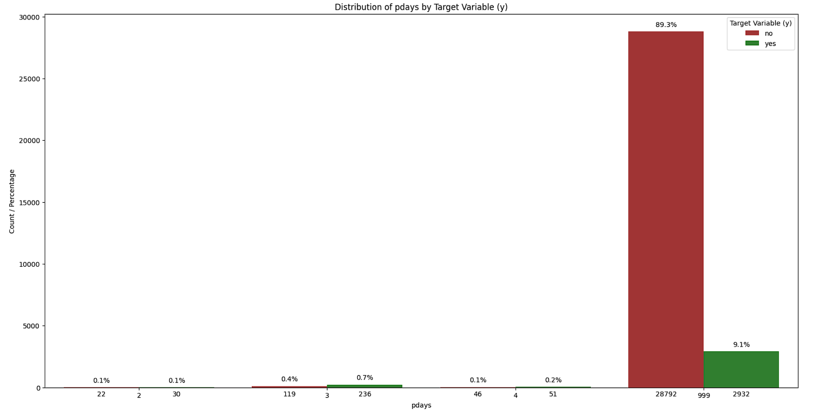
The influence of "Pdays" on term deposit subscriptions.
Contact Frequency Insights: Stability at two to four engagements; 0.7% positive response at three contacts. Surprisingly, clients never contacted (999 times) show 9.1% positive response amid an 89.3% rejection rate. Highlights nuanced impact, urging strategic engagement after initial rejection.

Slide 8
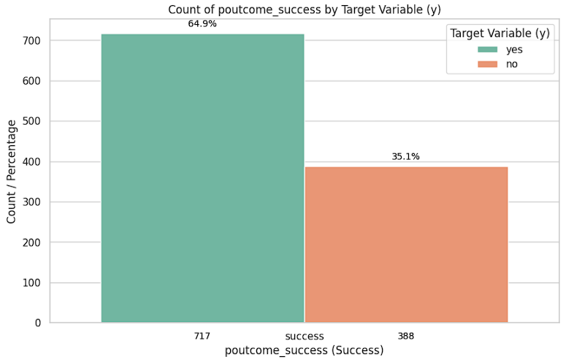
Influencing Term Deposit Outcomes: A Comprehensive Campaign Analysis
Analyzing 'poutcome' data reveals a robust 64.9% success rate from the previous campaign, contrasting with a 35.1% negative outcome. This guides future strategies, reinforcing our commitment to leveraging success for ongoing optimization.

Slide 9
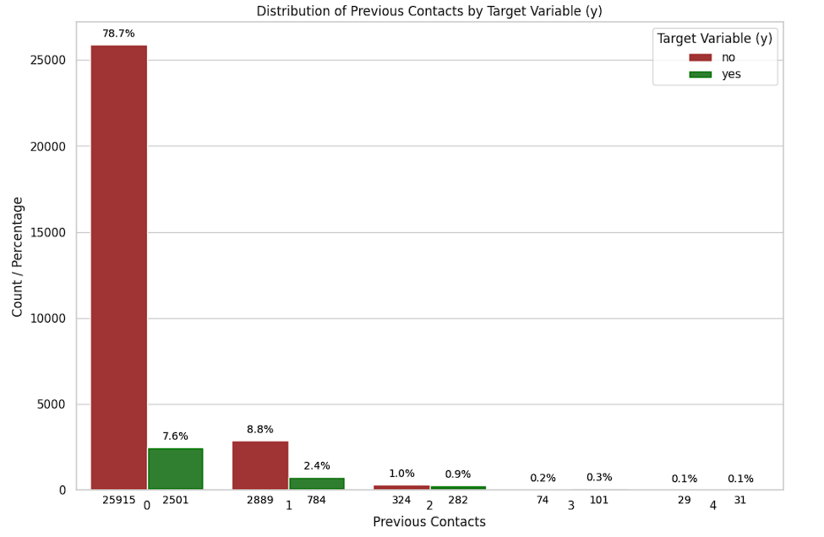
Influencing Term Deposits: Analyzing Previous Contacts
The 'previous' variable shows that clients with no prior contacts (0) have a 78.8% rejection rate and a 7.6% positive response rate. As previous contacts increase, rejection rates decline—8.8% for 1 contact, 1.0% for 2 contacts, and 0.2% for 3 contacts. Positive response rates follow suit, emphasizing the benefits of sustained engagement over time.

Slide 10
Next Steps and Recommendations
Segmentation: Divide clients for targeted insights.
Tailored Campaigns: Customize strategies for segments with higher positive responses.
Refined Communication: Enhance engagement with personalized messaging.
Feedback Mechanism: Establish a system to understand the reasons behind rejections.
A/B Testing: Experiment with variations for optimization.
Data Monitoring: Continuously adapt strategies based on evolving patterns.
Cross-Channel Integration: Incorporate insights into broader marketing strategies.
Advanced Strategy:
To improve our approach, we must concentrate on the top 10,000 customers who have responded positively. We must engage with them proactively and reassess the model based on their feedback. We can continually refine the model by iterating this process, ensuring a robust and well-informed approach. This approach aligns with our commitment to achieving positive outcomes and fostering a dynamic refinement cycle for enduring success.

Slide 11
Operationalizing Success: Deploying, Maintaining, and Protecting the Model
Productize the Model:
Transform the refined model insights into a deployable and scalable solution, integrating it into the operational workflow.
Retraining Frequency:
Define a retraining schedule to keep the model updated with the latest data trends, ensuring its ongoing relevance and effectiveness.
Model Performance Threats:
Identify and mitigate potential threats to model performance, considering factors such as data drift, changing client behaviors, and external market dynamics.

